Slide 1
Biodiversity Analysis Across National Parks
Exploring Species Distribution and Conservation Status
Safa Hamdare

Slide 2
Objective
Analyze biodiversity data across national parks
Understand species distribution by category
Examine conservation status of species
Explore observation patterns across parks

Slide 3
Dataset Overview
species_info.csv
Species name, category, conservation status
observations.csv
Species sightings across parks (7 days)
Data merged for combined analysis

Slide 4
Data Preparation
Checked data types and structure
Handled missing values in conservation status
Replaced missing values with “Not Listed”
Merged datasets using scientific name

Slide 5
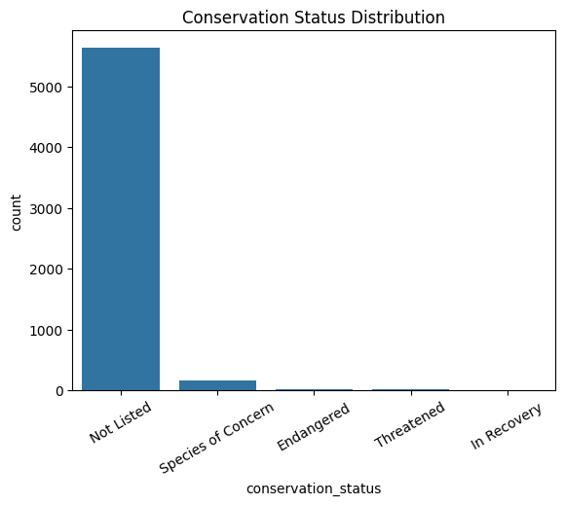
Conservation Status Distribution
Majority of species are not at risk
Smaller proportion classified as:
Endangered
Threatened
Species of concern

Slide 6
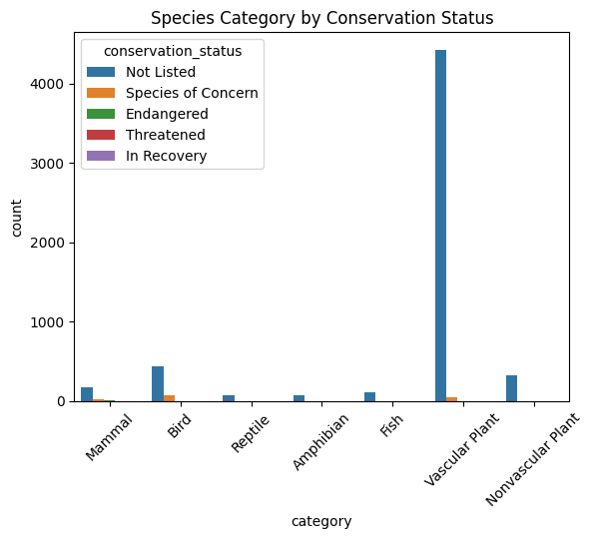
Species Category Analysis
Categories include:
Mammals
Birds
Fish
Plants
Mammals & birds show higher risk levels
Conservation risk varies by category

Slide 7
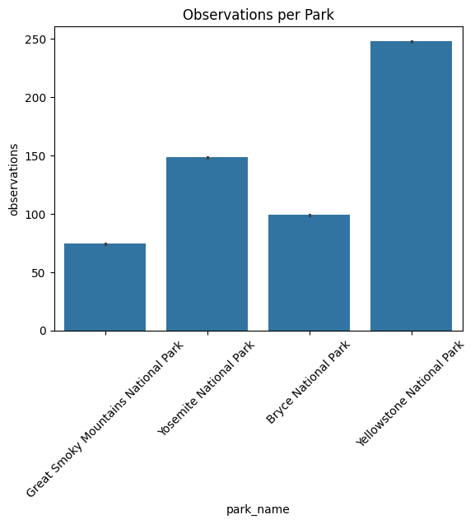
Observations Across Parks
Observations differ across parks
Some parks show significantly higher activity
Could indicate:
Higher biodiversity
Larger park size
More observation effort

Slide 8
Key Insights
Most species are not under conservation concern
Mammals and birds have higher protection levels
Biodiversity varies across parks
Conservation efforts should focus on vulnerable categories

Slide 9
Limitations
Data limited to 7 days
Missing conservation data required assumptions
External factors (climate, human activity) not included
Observations may reflect effort, not actual biodiversity

Slide 10
Conclusion
Biodiversity is generally stable across parks
Some species groups require closer monitoring
Data highlights importance of conservation strategies
Analysis supports data-driven environmental decisions

